Slide 1
CAP476:
Data Communication and Networking
Unit-II
Physical Layer

Slide 2
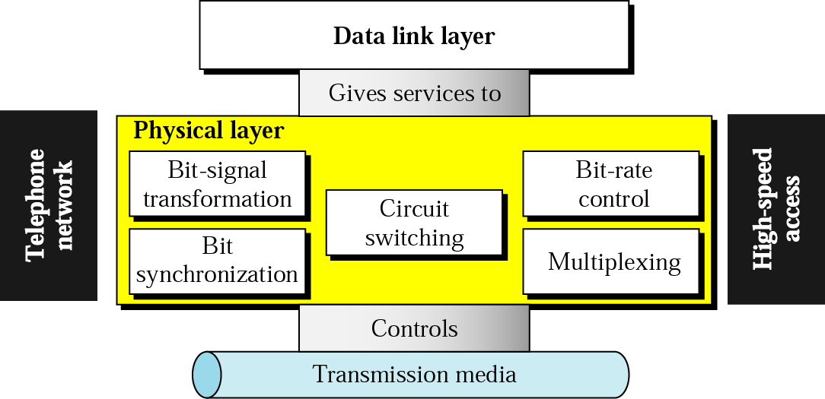
Physical Layer
Interacts with transmission media directly.
Physical part connecting components together.
Carries information node to node.
Provides services for data link.
Handles complex physical-layer tasks.

Slide 3
Data and Signals
Data-link frames are bits.
Bits must become signals.
Physical layer creates signals.
Signals traverse transmission medium.
Enables end-to-end transport.

Slide 4
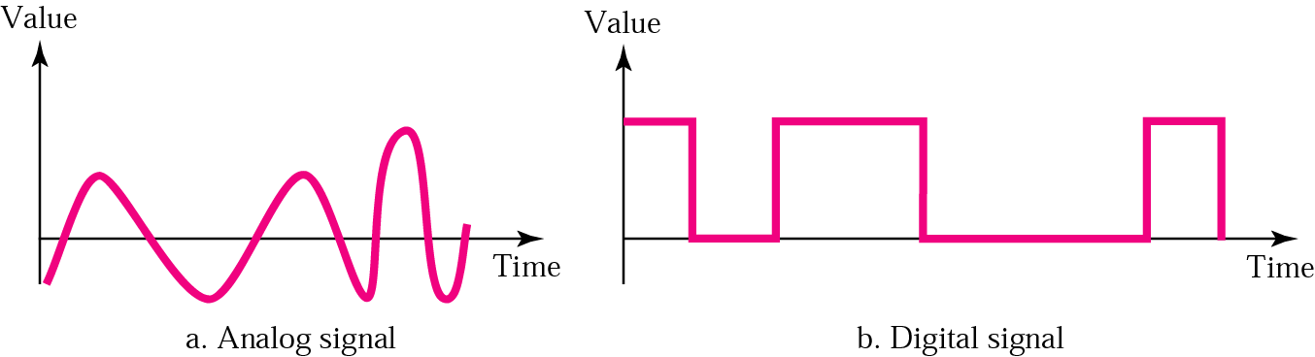
Signal types
Signals can be analog.
Signals can be digital.
Analog: infinite value range.
Digital: limited discrete values.
Choice driven by design needs.

Slide 5
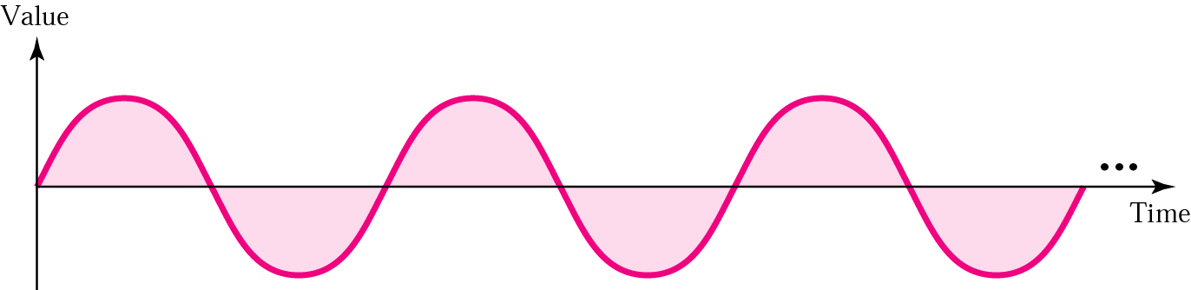
Analog Signal
Analog signals: simple or composite.
Always periodic in this context.
Simple periodic signal: sine wave.
Sine cannot be decomposed further.
Composite: multiple sine components.

Slide 6
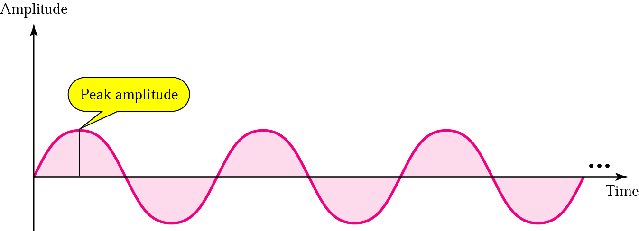
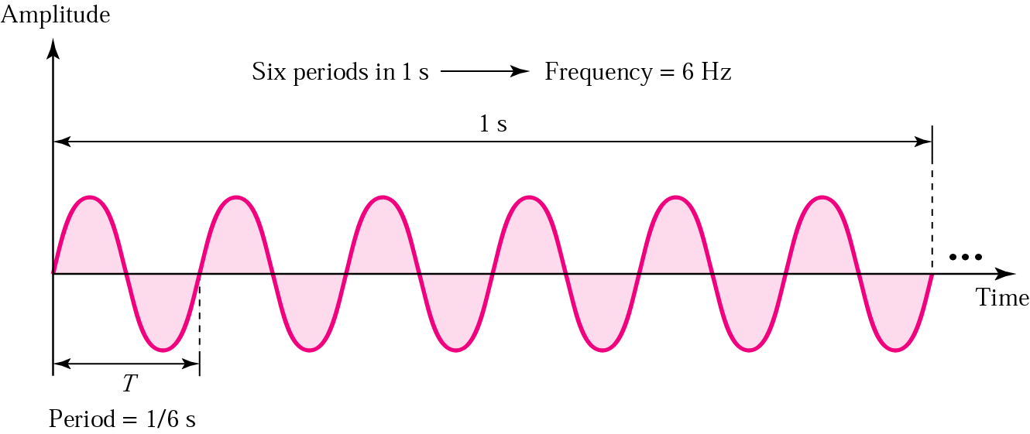

Slide 7
Frequency is the rate of change with respect to time. Change in a short span of time means high frequency. Change over a long span of time means low frequency.
If a signal does not change at all, its frequency is zero. If a signal changes instantaneously, its frequency is infinite.

Slide 8
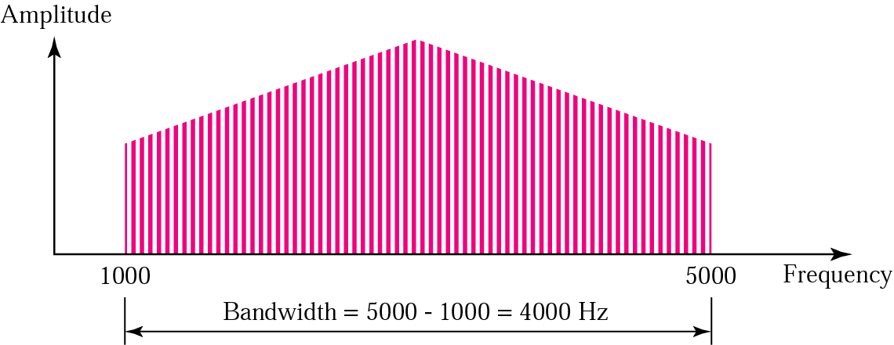
The bandwidth is a property of a medium: It is the difference between the highest and the lowest frequencies that the medium can satisfactorily pass.

Slide 9
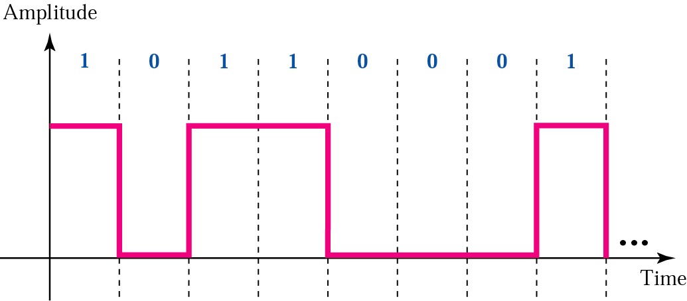
Digital Signal
A digital signal is a composite signal with an infinite bandwidth.

Slide 10
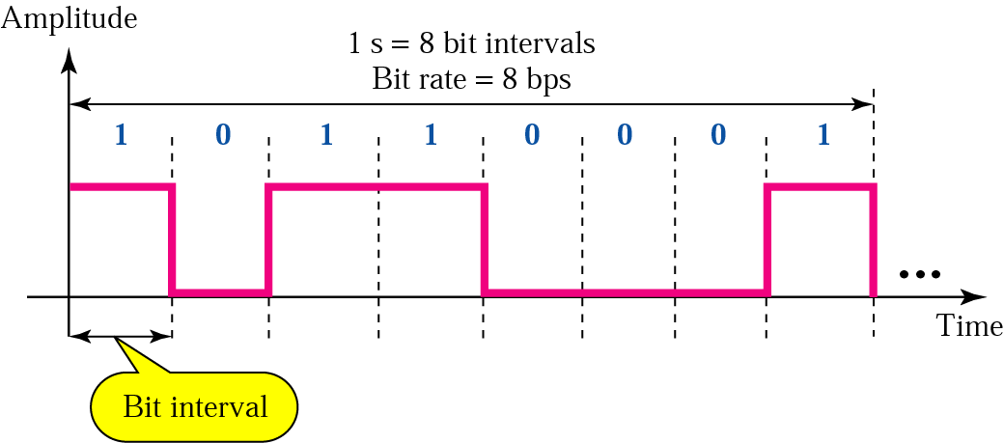

Slide 11
Digital v/s Analog
Analog: continuous value signals.
Digital: discrete value signals.
Analog often periodic sines.
Digital composite, bandwidth-limited edges.
Physical layer carries both

Slide 12
THANK YOU

